Slide 1
Covid19 Project

Slide 2

Project Overview
Covid19 data analytics
Process the covid19 Data
Data Visualization
Build end to end pipeline
Job Scheduling and Orchestration

Slide 3
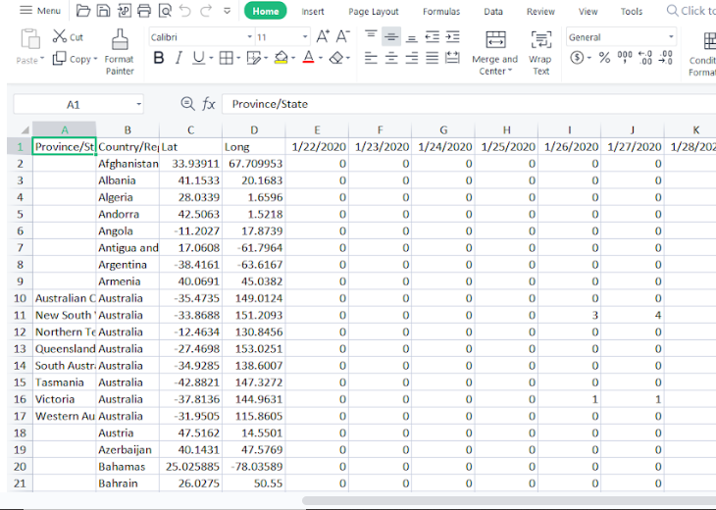
Source Data

Slide 4
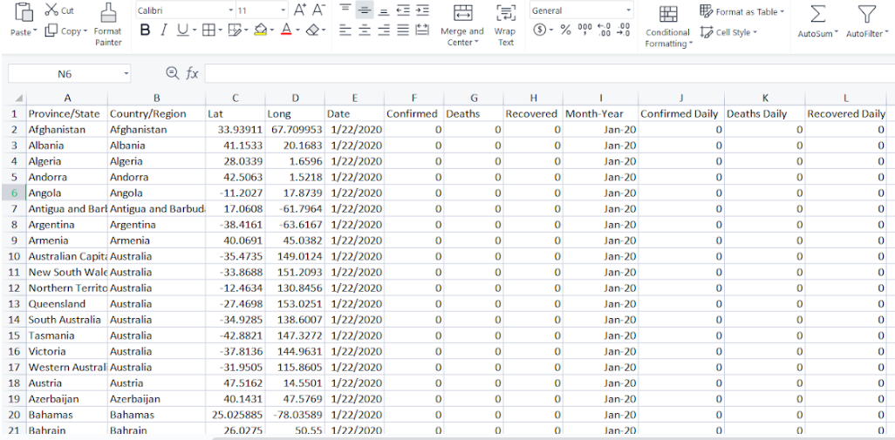
Expected Output

Slide 5

Transformation and Ingestion
Preprocess
Visualization
Data Lake
Analytics

Slide 6
Next: Architecture

Slide 7
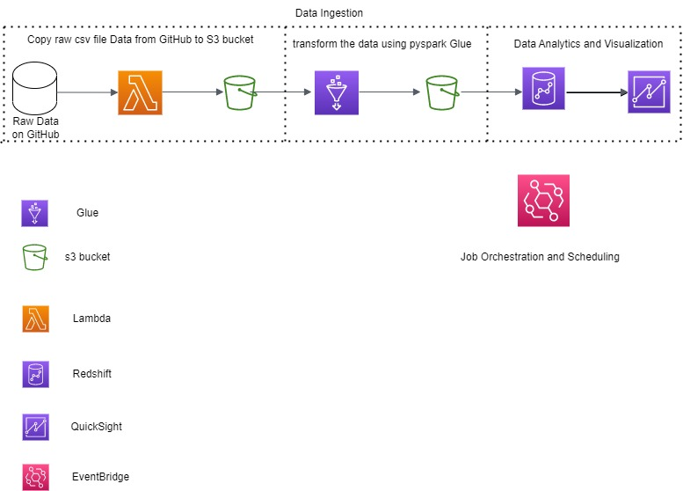
Architecture

Slide 8







AWS Tech Stack
Visualization
Data Lake
Scheduling and Orchestration
Preprocess
Data Transformation and Ingestion
Analytics

Slide 9
What is a Data Lake?

Slide 10
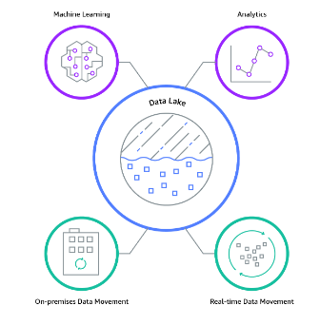
Data Lake
Elements of Data Lake
Data Movement
Analytics
Machine Learning
Securely Store, and catalog data.
Value of Data Lake
Improved Customer Interactions
Imrpove R &D innovation choices
Increase operational efficiences

Slide 11
S3 Overview
One of the Main building block of AWS
It’s advertised as ‘infinitely scaling’ storage
Many websites use Amazon S3 as backbone
Many AWS services use S3 as in Integration as well

Slide 12
S3 buckets
Amazon s3 allows people to store objects(files) in buckets.
Buckets have a globally unique name(across all region accounts)
Buckets are defined at the region level
S3 looks like a global service but buckets are created in a region.
Naming Convention
No Unppercase, No underscore
3-63 characters long
Not an IP
Must start with a lowercase or number

Slide 13
S3 Objects
Objects have a key
The Key name is FULL path
s3://my-bucket/my_file.txt
The key is composed of prefix+object name
s3://my-bucket/my_file.txt
There is no concept of directories within buckets.
Object values are the content of bodies
Max object size is 5TB.(5000 GB).
If uploading more than 5 GB, must use multi part upload.

Slide 14
Next : Preprocess

Slide 15
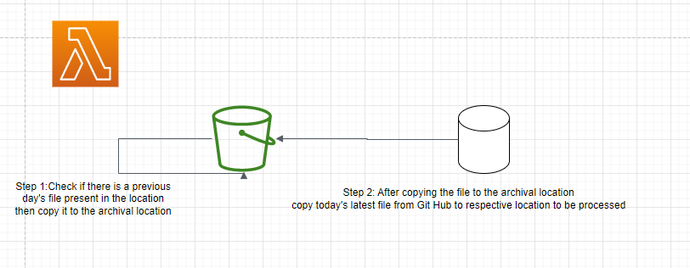
Preprocess Flow

Slide 16
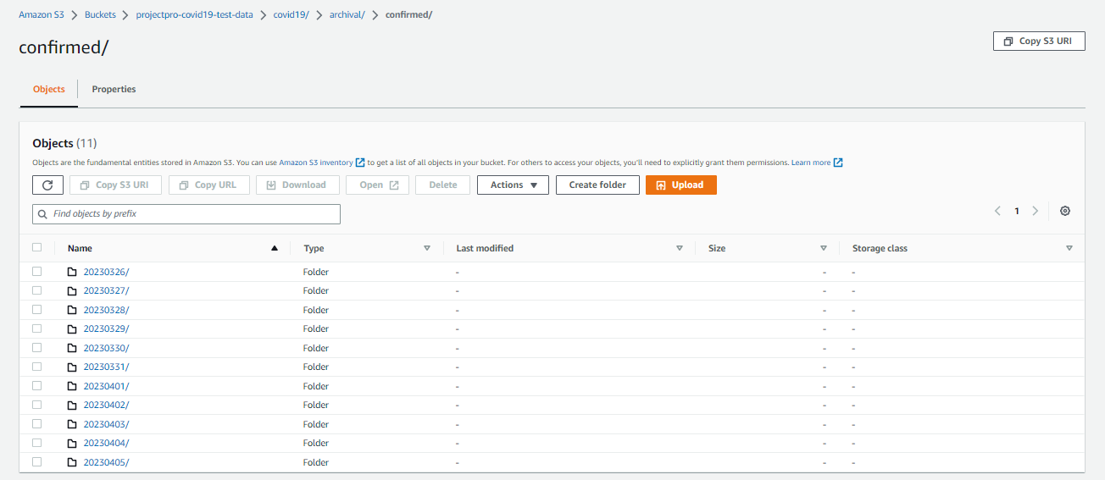
Archival Location

Slide 17
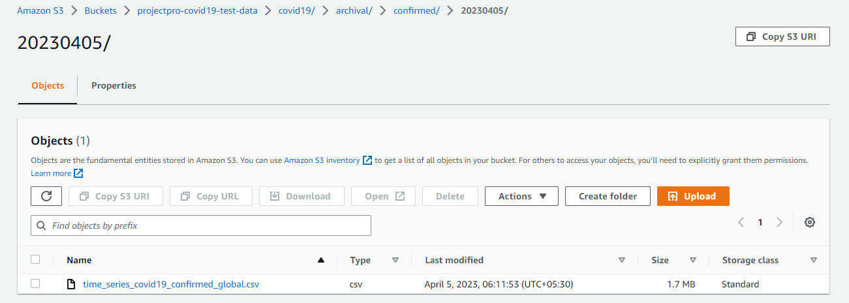

Slide 18
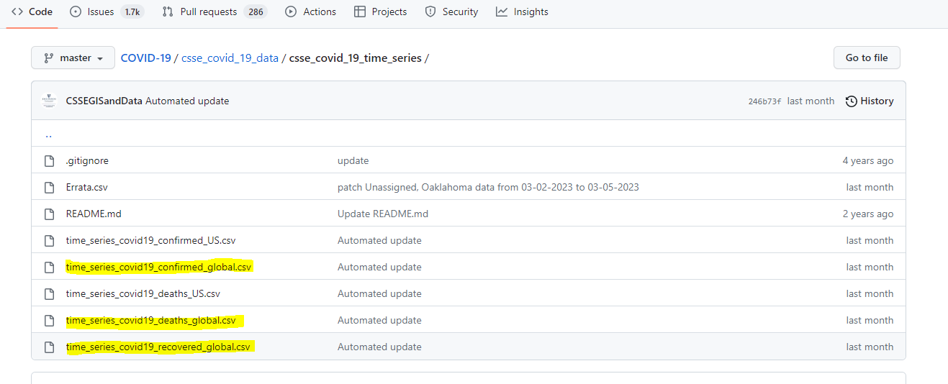
Source Git Hub Location

Slide 19
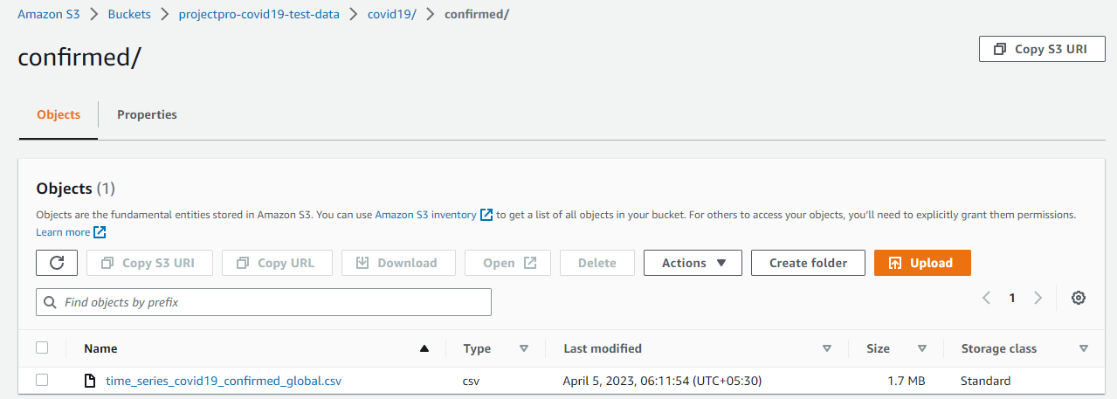
Target Location

Slide 20
AWS Lambda
EC2
Virtual Servers in the Cloud
Limited by RAM and CPU
Continuously Running
Scaling means intervention to add/remove servers.
Lambda
Virtual Functions – no servers to manage!
Limited by time – short executions
Run on-demand
Scaling is automated.

Slide 21
Benefits of Lambda
Easy Pricing
Integrated with many aws services
Easy Monitoring through AWS CloudWatch
Easy to get more Resources per functions(up to 10GB of RAM)
Increasing RAM will also improve CPU and Network.

Slide 22
Lambda Limits
Execution Limits
Memory Allocation – 128MB – 10GB
Maximum execution time: 900 seconds(15 mins)
Environment variables(4 KB)
Concurrency Executions: 1000 (can be increased)
Deployment
Deployment size(compressed .zip): 50 MB
Size of uncompressed deployment(code + dependencies): 250 MB

Slide 23
Language Support for Lambda
Node.js
Go
Python
Java(Java 8 Compatible)
C#(.Net Core)
Golang
C#/ Powershell
Ruby
Custom Routine API

Slide 24
AWS Glue
Managed extract,transform and load(etl) service.
Useful to prepare and transform data for analytics.
Fully serverless service.
With Glue, you can discover and connect more than 70 diverse data sources and manage your data in a centralized data catalog.

Slide 25
Sample Data Sources
Amazon S3
Amazon DynamoDB
Amazon Redshift
Amazon Relational Database Service (Amazon RDS)
Third-party JDBC-accessible databases
MongoDB and Amazon DocumentDB (with MongoDB compatibility)
Other marketplace connectors and Apache Spark plugins
Data Streams
Kinesis
Kafka

Slide 26
Glue Catalog:persistent metadata store in AWS Glue. It contains table definitations, job definitations and other ocntrol information.
Each AWS account has one Glue Data Catalog.

Slide 27
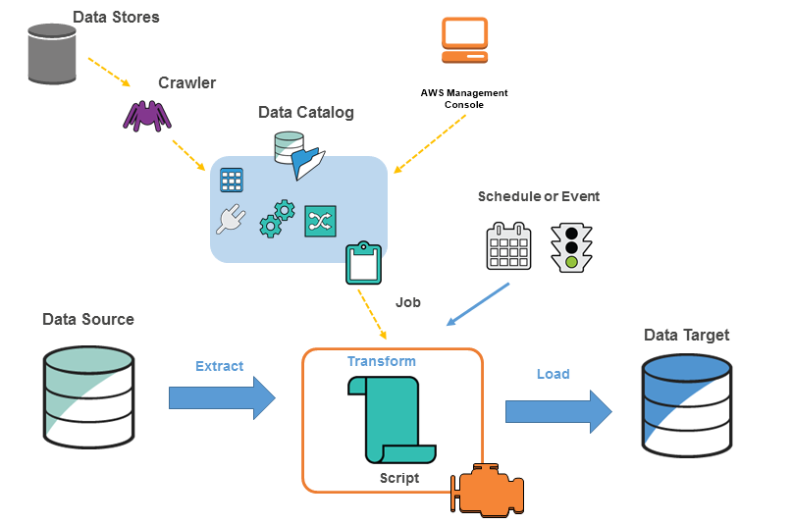

Slide 28
Next: Data Transformation and Ingestion

Slide 29
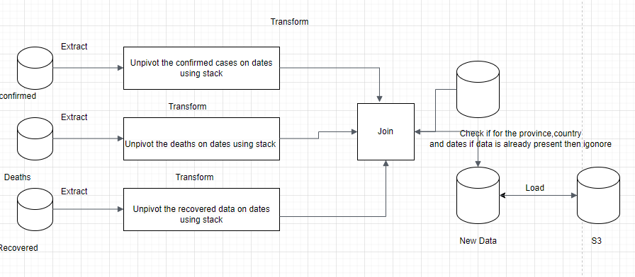
Data Transformation and Ingestion
How?
ETL(Extract Transform Load) Process.

Slide 30
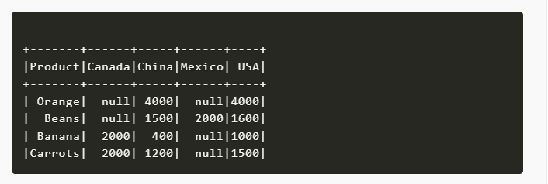
Unpivot Operation

Slide 31
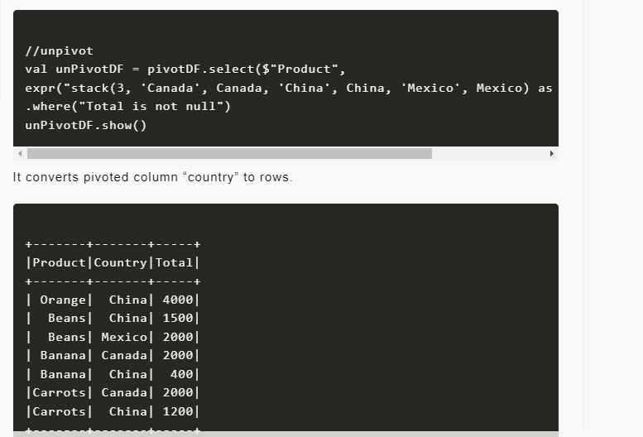

Slide 32
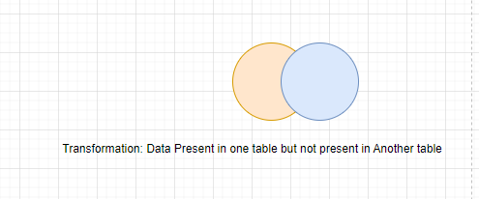
Anti Join Transformation

Slide 33
Analytics

Slide 34
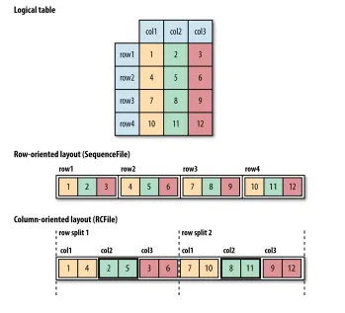
Columnar Storage

Slide 35
AWS Redshift
Redshift is based on PostgreSQL, but its not used for OLTP.
Its OLAP – online analytical processing(analytics and data warehouse)
10x better performance than other data warehouses, scale to PBs
Columnar storage of data & parallel query engine
Pay as you go based on the instances provisioned.
Has a SQL interface for performing the queries
BI tools such as Amazon Quicksight or Tableau integrate with it
Vs Athena: faster queries/joins/aggregations. Thanks to indexes

Slide 36
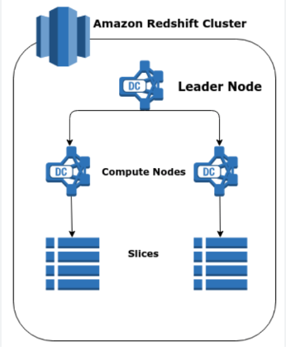
Redshift Cluster
Leader Node: for query planning, results aggregation.
Compute node: for performing the queries, send results to leader
You provision the node in advance
You can used Reserved instances for cost savings

Slide 37
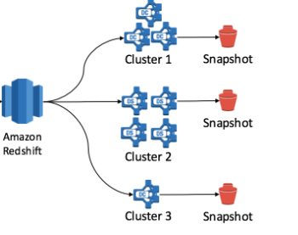
Redshift snapshots
Redshift has Multi AZ mode for some clusters
Snapshots are point in time backups of a cluster
Snapshots are incremental
You can restore a snapshot into a new cluster.
You can configure Amazon Redshift to automatically copy snapshots of a cluster to another AWS region

Slide 38
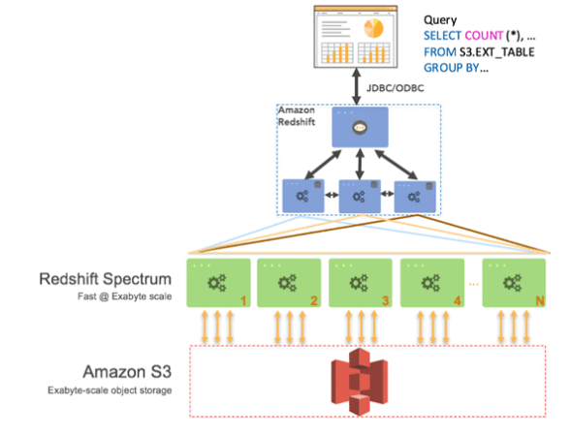
Redshift Spectrum
Query data that is already in S3 without loading it.
Must have a Redshift cluster available to start the query
The query is then submitted to thousands of Redshift Spectrum nodes.

Slide 39
Redshift spectrum table steps
Creation of external schema in redshift database with IAM Role
Create an external table In schema
Query the table

Slide 40
Amazon Quicksight
Serverless machine learning-powered business intelligence service to create interactive dashboards.
Fast, automatically scalable,embeddable, with per-session pricing.
Integrated with RDS,Aurora,Athena,Redshift,S3,etc.
In-memory computation using SPICE engine if data is imported into quicksight.
Use cases
Business Analytics
Building Visualizations
Perform ad-hoc analysis
Get business insights using data

Slide 41
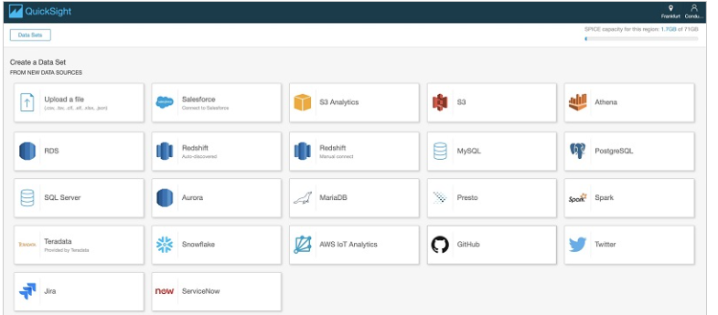
QuickSight Integration

Slide 42
QuickSight Dashboard and Analysis
Define Users(standard versions) and Groups(enterprise version)
These users & groups only exist within QuickSight, not IAM
A dashboard…
Is a read only snapshot of an analysis that you can share
Preserves the configuration of the analysis.
You can share the analysis or the dashboard with Users or Groups.
To share a dashboard, you must first publish it.
Users who see the dashboard can also see the underlyng data

Slide 43
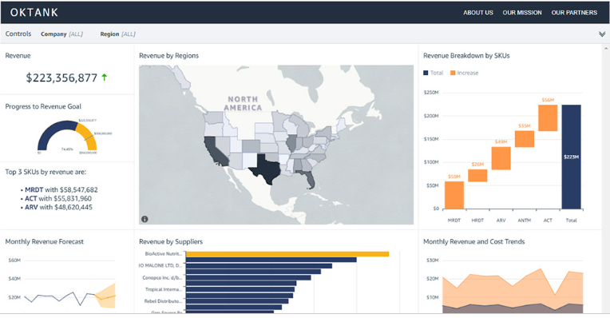
Dashboard

Slide 44
Amazon Eventbridge
Amazon EventBridge
Connects application components together through events
Receives an event, an indicator of a change in environment, and applies a rule to route the event to a target.
Rules match events to targets based on either structure of the event, called an event pattern or schedule.
All events that come to EventBridge are associated with an event bus. Rules are tied to a single event bus.

Slide 45
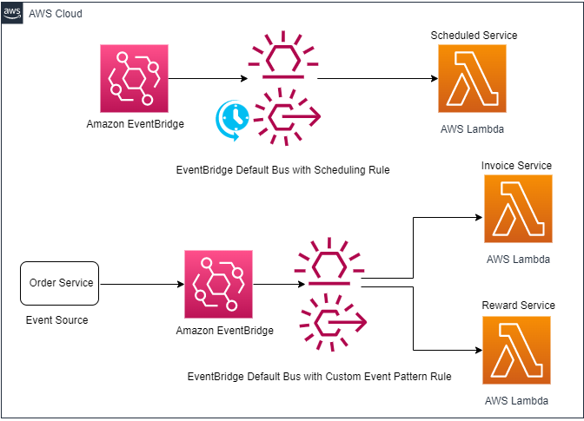

Slide 46
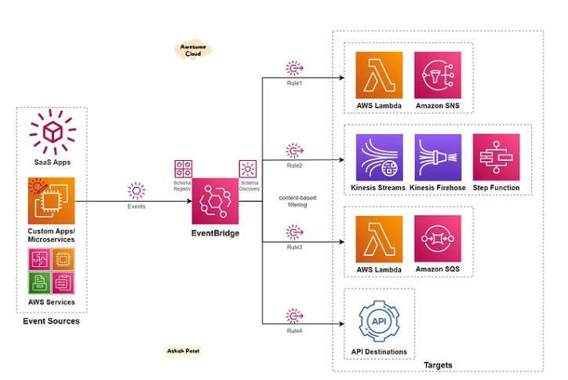
Eventbridge Rule

Slide 47
Scheduling & Orchestration
Eventbridge Schedule to trigger copyGitHubS3 Lambda
copyGitHubS3
EventBridge rule to trigger the glujob launch lambda
Eventbridge rule to invoke launch glue job
Luanch Glue job Lambda
Eventbridge Rule to check glue job status lambda
Even Rule to invoke glue job status lambda
Glue job status Lambda

Slide 48
Q & A

